Slide 1


<Name>
<Date>

Slide 2

Outline
Executive Summary
Introduction
Methodology
Results
Conclusion
Appendix

Slide 3
Executive Summary
Methodologies:
Encode categorical features using One Hot Encoder
Predict a landing’s success using basic machine learning algorithms: Logistic Regression, Support Vector Machines, K Nearest Neighbors and Multinominal Naïve Bayes
Result:
All models have an accuracy of 83.33% on test set
The major problem of all models are the number of false positives, 3.

Slide 4
Introduction
Space travel is becoming commercially available
Landing successful ➔ first stage reused ➔ travel’s cost considerably saved
Our problem: determining whether a landing is successful or not based on multiple factors:
Payload’s mass
Orbit type
Launch site
Number of flights
Having grid fins or not
Reused counting
Block number
Landing pad’s code

Slide 5

Section 1

Slide 6
Methodology
Executive Summary
Data collection methodology:
Describe how data was collected
Perform data wrangling
Describe how data was processed
Perform exploratory data analysis (EDA) using visualization and SQL
Perform interactive visual analytics using Folium and Plotly Dash
Perform predictive analysis using classification models
How to build, tune, evaluate classification models

Slide 7
Data Collection
Dataset used: SpaceX Launch Data
Data is collected by calling SpaceX’s API, i.e. making a GET request to https://api.spacexdata.com/v4/[endpoint]
[endpoint] is:
/launches/past: get comprehensive past launch data and is the need to get data from the below endpoints
/rockets/: get booster’s name
/launchpads/: get launch site’s name, latitude and longtitude of each launch
/payloads/: payload’s mass and orbit of each launch
/cores/: landing’s outcome, number of flights, block number, etc.

Slide 8
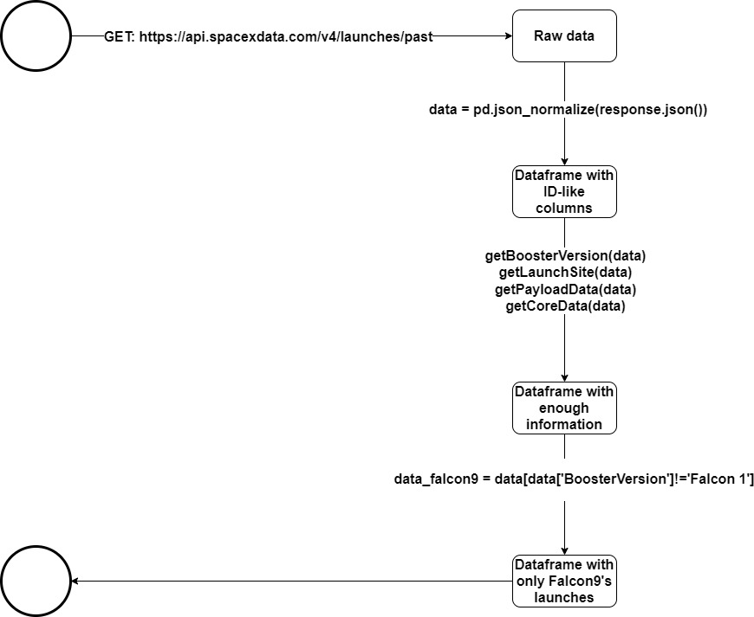
Data Collection – SpaceX API
Place your flowchart of SpaceX API calls here
GET request ➔Raw data ➔ Some converts ➔ Final dataframe
Reference this notebook

Slide 9
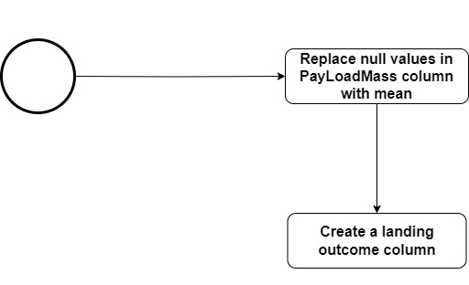
Data Wrangling
Calculating the number of null values in each column
Converting null value to the mean of that column
Reference this notebook

Slide 10
EDA with Data Visualization
Categorical plots: to see the relationship between FlightNumber, PayloadMass, LaunchSite and the launch outcome
Bar chart: to see the relationship between success rate and orbit type
Scatter plot: to see the relationship between FlightNumber, PayloadMass, Orbit and the launch outcome
Line plot: to see the success rate from 2010 to 2020
Reference this notebook

Slide 11
EDA with SQL
Using bullet point format, summarize the SQL queries you performed
Add the GitHub URL of your completed EDA with SQL notebook, as an external reference and peer-review purpose

Slide 12
Build an Interactive Map with Folium
Circle: highlight an area with specific coordinates, e.g. NASA Johnson Space Center
Marker: add text label to a Circle object or a PolyLine object
Circle group: add a circle polygon surrounding an area
Marker cluster: group markers with the same coordinates
PolyLine: draw a line between two destinations
Reference this notebook

Slide 13
Build a Dashboard with Plotly Dash
Summarize what plots/graphs and interactions you have added to a dashboard
Explain why you added those plots and interactions
Add the GitHub URL of your completed Plotly Dash lab, as an external reference and peer-review purpose

Slide 14
Predictive Analysis (Classification)
Summarize how you built, evaluated, improved, and found the best performing classification model
You need present your model development process using key phrases and flowchart
Add the GitHub URL of your completed predictive analysis lab, as an external reference and peer-review purpose

Slide 15
Results
Exploratory data analysis results
Interactive analytics demo in screenshots
Predictive analysis results

Slide 16

Section 2

Slide 17
Flight Number vs. Launch Site
Show a scatter plot of Flight Number vs. Launch Site
Show the screenshot of the scatter plot with explanations

Slide 18
Payload vs. Launch Site
Show a scatter plot of Payload vs. Launch Site
Show the screenshot of the scatter plot with explanations

Slide 19
Success Rate vs. Orbit Type
Show a bar chart for the success rate of each orbit type
Show the screenshot of the scatter plot with explanations

Slide 20
Flight Number vs. Orbit Type
Show a scatter point of Flight number vs. Orbit type
Show the screenshot of the scatter plot with explanations

Slide 21
Payload vs. Orbit Type
Show a scatter point of payload vs. orbit type
Show the screenshot of the scatter plot with explanations

Slide 22
Launch Success Yearly Trend
Show a line chart of yearly average success rate
Show the screenshot of the scatter plot with explanations

Slide 23
All Launch Site Names
Find the names of the unique launch sites
Present your query result with a short explanation here

Slide 24
Launch Site Names Begin with 'CCA'
Find 5 records where launch sites begin with `CCA`
Present your query result with a short explanation here

Slide 25
Total Payload Mass
Calculate the total payload carried by boosters from NASA
Present your query result with a short explanation here

Slide 26
Average Payload Mass by F9 v1.1
Calculate the average payload mass carried by booster version F9 v1.1
Present your query result with a short explanation here

Slide 27
First Successful Ground Landing Date
Find the dates of the first successful landing outcome on ground pad
Present your query result with a short explanation here

Slide 28
Successful Drone Ship Landing with Payload between 4000 and 6000
List the names of boosters which have successfully landed on drone ship and had payload mass greater than 4000 but less than 6000
Present your query result with a short explanation here

Slide 29
Total Number of Successful and Failure Mission Outcomes
Calculate the total number of successful and failure mission outcomes
Present your query result with a short explanation here

Slide 30
Boosters Carried Maximum Payload
List the names of the booster which have carried the maximum payload mass
Present your query result with a short explanation here

Slide 31
2015 Launch Records
List the failed landing_outcomes in drone ship, their booster versions, and launch site names for in year 2015
Present your query result with a short explanation here

Slide 32
Rank Landing Outcomes Between 2010-06-04 and 2017-03-20
Rank the count of landing outcomes (such as Failure (drone ship) or Success (ground pad)) between the date 2010-06-04 and 2017-03-20, in descending order
Present your query result with a short explanation here

Slide 33

Section 3

Slide 34
<Folium Map Screenshot 1>
Replace <Folium map screenshot 1> title with an appropriate title
Explore the generated folium map and make a proper screenshot to include all launch sites’ location markers on a global map
Explain the important elements and findings on the screenshot

Slide 35
<Folium Map Screenshot 2>
Replace <Folium map screenshot 2> title with an appropriate title
Explore the folium map and make a proper screenshot to show the color-labeled launch outcomes on the map
Explain the important elements and findings on the screenshot

Slide 36
<Folium Map Screenshot 3>
Replace <Folium map screenshot 3> title with an appropriate title
Explore the generated folium map and show the screenshot of a selected launch site to its proximities such as railway, highway, coastline, with distance calculated and displayed
Explain the important elements and findings on the screenshot

Slide 37

Section 4

Slide 38
<Dashboard Screenshot 1>
Replace <Dashboard screenshot 1> title with an appropriate title
Show the screenshot of launch success count for all sites, in a piechart
Explain the important elements and findings on the screenshot

Slide 39
<Dashboard Screenshot 2>
Replace <Dashboard screenshot 2> title with an appropriate title
Show the screenshot of the piechart for the launch site with highest launch success ratio
Explain the important elements and findings on the screenshot

Slide 40
<Dashboard Screenshot 3>
Replace <Dashboard screenshot 3> title with an appropriate title
Show screenshots of Payload vs. Launch Outcome scatter plot for all sites, with different payload selected in the range slider
Explain the important elements and findings on the screenshot, such as which payload range or booster version have the largest success rate, etc.

Slide 41

Section 5

Slide 42
Classification Accuracy
Visualize the built model accuracy for all built classification models, in a bar chart
Find which model has the highest classification accuracy

Slide 43
Confusion Matrix
Show the confusion matrix of the best performing model with an explanation

Slide 44
Conclusions
Point 1
Point 2
Point 3
Point 4
…

Slide 45
Appendix
Include any relevant assets like Python code snippets, SQL queries, charts, Notebook outputs, or data sets that you may have created during this project

Slide 46


